Slide 1
Nurse Attrition Analysis & Retention Strategies
Capstone Project
CSIS 503 Data Science and Analytics
Summer 2025

Slide 2
Group # 2
Team Members
Edoh, Ngozi - ngoziedoh@osiriuniversity.org
Samuel Gebresilassie - samgebresilassie@osiriuniversity.org
Babajide Gboyega Alalade - babajide@osiriuniversity.org
Peter Kennedy Akech - peterakech@osiriuniversity.org
Edward Odoom - edodoom@osiriuniversity.org
Guluma Berhanu - guluma@osiriuniversity.org

Slide 3


Table of Contents
Introduction & Objective
Dataset Description
Methodology
Key Findings and Results
Insights & Recommendations
Limitations
References & Acknowledgement

Slide 4
Introduction & Objective
Nurse attrition is a critical challenge in healthcare, directly impacting patient care quality, staff morale, and operational costs.
This project analyzes nurse attrition within the organization to uncover key patterns, demographic trends, and contributing factors driving turnover.
By leveraging workforce data, the analysis identifies high-risk groups and explores relationships between attrition and variables such as tenure, compensation, overtime, and work-life balance.
The Objective: To provide evidence-based insights and propose targeted retention strategies that support a more stable, satisfied, and sustainable nursing workforce.

Slide 5
Dataset Description
Data Source - https://www.kaggle.com/datasets/jpmiller/employee-attrition-for-healthcare
Size & Structure – ( Rows: 1,676; Columns: 35)
Key Variables/Features: The dataset contains demographic, job-related, and satisfaction attributes.
Some notable ones:
Employee Information: EmployeeID (Unique Identifier), Age, Gender
Attrition / Target Variable: Yes/No (whether the nurse left)
Job & Department: Department, JobRole, JobLevel, Shift
Compensation: DailyRate, HourlyRate, MonthlyIncome, MonthlyRate, PercentSalaryHike

Slide 6
Dataset Description
Key Variables/Features
Satisfaction & Engagement: EnvironmentSatisfaction, JobSatisfaction, RelationshipSatisfaction, WorkLifeBalance,
JobInvolvement
Experience: TotalWorkingYears, YearsAtCompany, YearsInCurrentRole, YearsSinceLastPromotion,
YearsWithCurrManager, NumCompaniesWorked
Other: Education, EducationField, OverTime, StandardHours, PerformanceRating, EmployeeCount

Slide 7
Methodology
Define Objective
Data Understanding
(Size, Features, Target)
Data Preparation
(Cleaning)
Exploratory Data Analysis
(EDA)
Interpretation & Insights
(Key Drivers of Attrition)
Model Evaluation
Model Building
(Random Forest)

Slide 8
EDA Steps and Techniques Used
Data Overview
Rows, Columns, Datatypes, Missing Values
Target Variable Analysis
Using Pie Chart
Univariate Analysis
Numerical and Categorical Features
Correlation Analysis
Correlation matirx + Heatmap
Attrition Drivers
Department, OverTime, WorkLifeBalance
Notes:
Get a sense of the dataset structure
Understand attrition distribution
Explore individual variables
Detect relationships between numerical features
Hypothesize predictors before modeling

Slide 9
Tools and Libraries
Tools
Excel and Python
Python Libraries
Pandas - for data loading, cleaning, wrangling (DataFrame operations)
Numpy - for numerical computations, arrays
Matplotlib - base plotting library
Seaborn - advanced statistical visualization
Scikit-learn – Splitting Data, Preprocessing, Encoding, Model, Model Validation,
Evaluation
Notes:
Get a sense of the dataset structure
Understand attrition distribution
Explore individual variables
Detect relationships between numerical features
Hypothesize predictors before modeling

Slide 10
Reasons For Chosen Methods
Random Forest Classifier
Handles both numerical and categorical features well
Captures non-linear relationships and feature interactions that logistic
regression may miss
Provides feature important scores, which are very useful for HR to
understand key attrition drivers
Robust to outliers and doesn’t require heavy scaling
Notes:
Get a sense of the dataset structure
Understand attrition distribution
Explore individual variables
Detect relationships between numerical features
Hypothesize predictors before modeling

Slide 11
Key Findings, Results & Insights

Slide 12
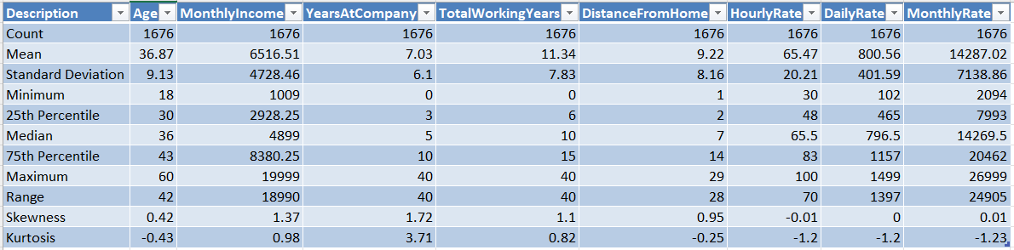
Nurse Attrition Descriptive Statistics
Nurse Mean Age is 36.9 years, with a range of 42 (from 18 to 60). The slight right skew (0.42) suggests a slightly younger workforce.
Mean Monthly Income is $6,516, Std Dev ($4,728) is very high, indicating income disparity, and skewness of 1.37 implies a small group of nurses earn significantly more.
Mean Years at Company (7.03) and Total Working Years (11.34) suggest nurses have experience from outside organizations, indicating external hiring is strong.
The mean distance is 9.2 miles, with some commuting as far as 29 miles, and the skewness of 0.95 shows more employees live closer, but a few travel far.
Hourly, daily, and monthly pay rates are evenly distributed, with the average hourly rate at 65.5 and a near-zero skew (-0.01), indicating no significant bias toward high or low values.
Years at Company and Monthly Income are both positively skewed (>1), suggesting that most employees are earlier in their careers or lower income brackets.

Slide 13
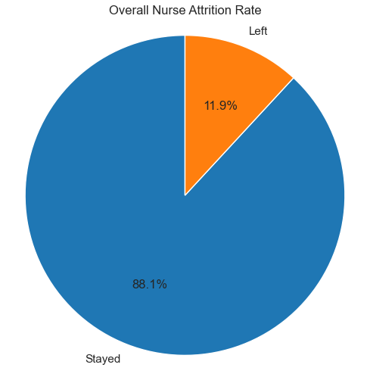
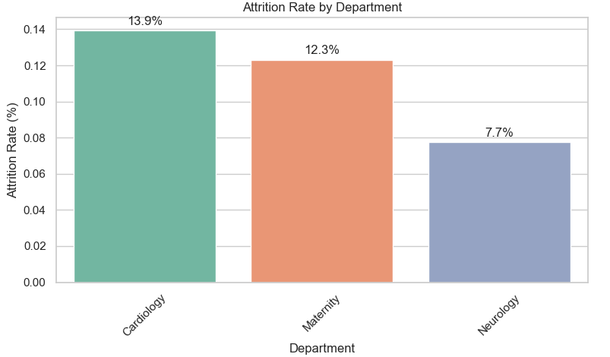
Current State of Nurse Attrition
Overall Attrition Rate
Attrition by Department
The overall nurse attrition rate is 11.9%, meaning that approx. 199 out of 1,676 nurses have left the organization. Although the remaining 88.1% are retained, an 11.9% attrition rate is a meaningful concern in a healthcare setting.
Department-wise, Cardiology and Maternity show the highest attrition rates, pointing to departmental
stress or dissatisfaction with higher rates in Cardiology (13.9%) and Maternity (12.3%).

Slide 14
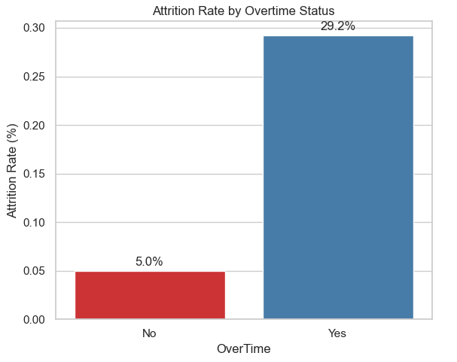
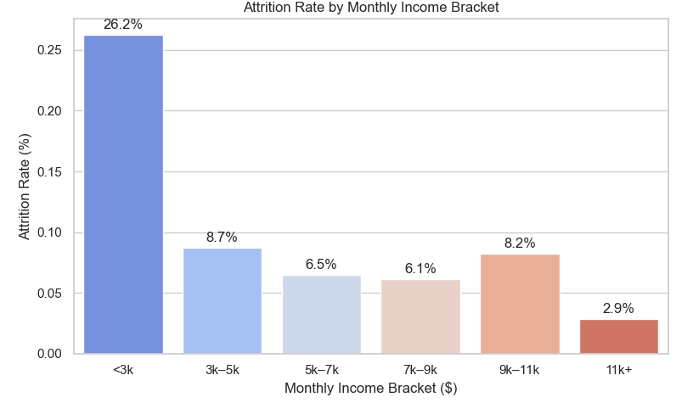
Key Factors Contributing to Turnover
Attrition Rate by Over Time Status
Attrition Rate by Monthly Income
Overtime is a strong predictor of nursing attrition, with turnover rates significantly higher among those working extra hours compared to those who do not. This suggests that excessive workload and burnout are major contributors to nurses leaving the organization.
Nurses in lower income brackets have higher attrition rates, indicating that compensation is a key factor in retaining early-career or lower-paid staff.

Slide 15
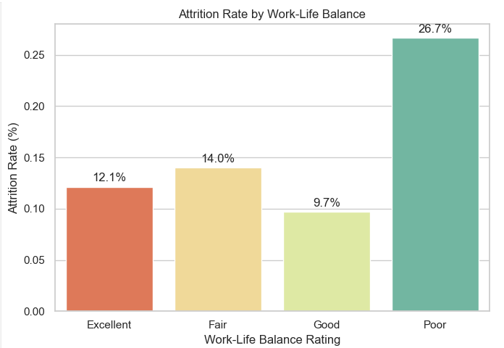
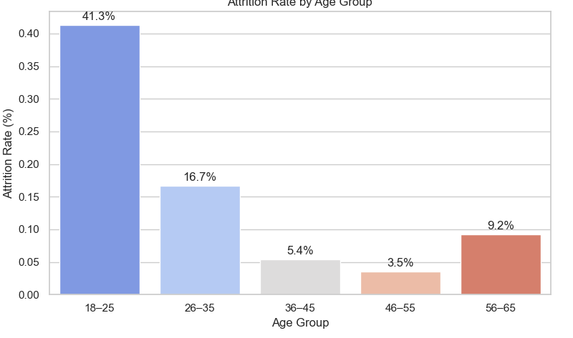
Key Factors Contributing to Turnover
Attrition Rate by Work-Life Balance
Attrition by Age Group
Work-life balance is a strong predictor of nurse attrition, with significantly higher turnover among those reporting low balance (poor). Nurses who feel unable to manage job demands alongside personal life are more likely to leave.
Attrition varies notably across demographics: younger nurses (18-25) experience the highest turnover, which indicates early-career instability.

Slide 16
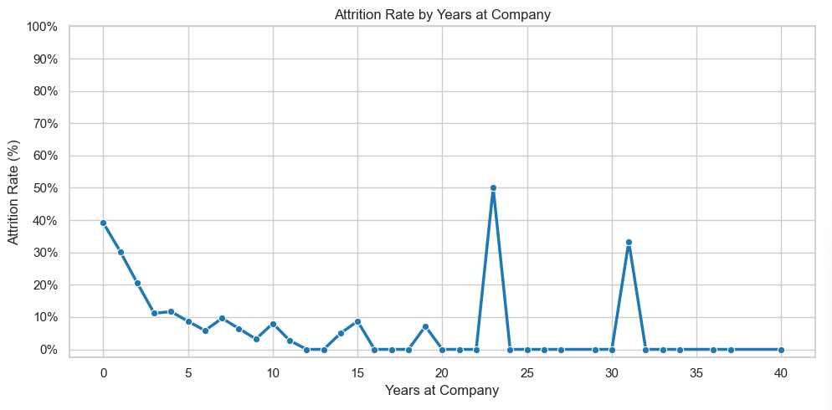
Trend Analysis
Attrition by Years at Company
Attrition over time reveals that nurses with 0–2 years of tenure have the highest turnover rates, indicating a severe early drop-off in employment.
Attrition decreases steadily with longer tenure, suggesting that those who remain beyond the initial years are more likely to stay long term.
This trend highlights the importance of strong onboarding, mentorship, and early engagement strategies to improve retention.

Slide 17
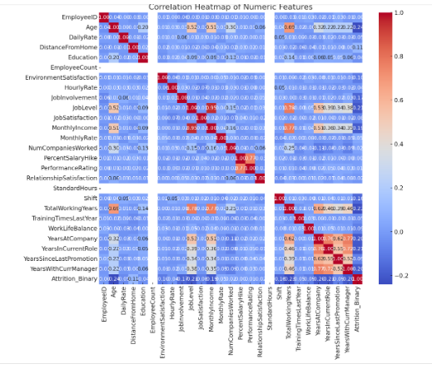
Correlation Heatmap of Numeric Features
+Corr: MonthlyIncome TotalWorkingYears (r~0.77)
More experienced nurses earn higher salaries.
+Corr: YearsAtCompany YearsInCurrentRole,
YearsWithCurrManager.
Longer tenure aligns with more time in the role and with the same manager.
There is –ve corr. Between Age and Attrition - as age increases, attrition tends to decrease, supporting the idea that younger nurses are more likely to leave
Variables such as Age, MonthlyIncome, WorkLifeBalance show weak correlation with Attrition_Binary (r<0.1).
Suggesting that attrition is not explained by any single numerical factor alone.

Slide 18
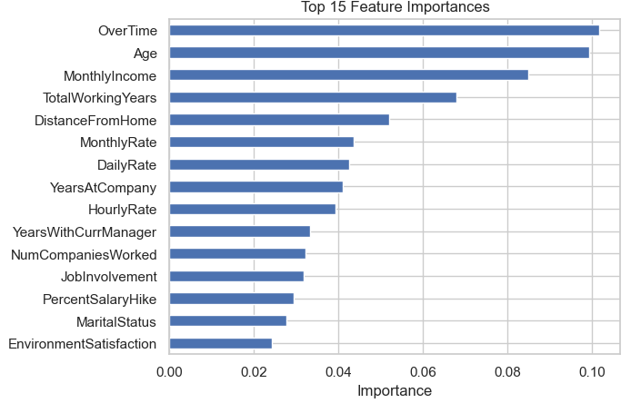
Top 8 Feature Importance
OT: Strongest predictor, high overtime is directly linked to higher attrition risk.
Age: Younger nurses are more likely to leave; attrition declines with age.
MI: Lower-income nurses tend to leave more, pointing to compensation dissatisfaction.
TWY: Less experienced nurses are at higher risk, reinforcing early-career turnover.
DFH: Longer commutes may contribute to disengagement or burnout.
M/DR: Correlated with compensation
YAC: Attrition is highest in the first 1–2 years; tenure is protective over time.

Slide 19
Conclusion
The analysis of nurse attrition reveals that turnover is not random; it is concentrated among specific groups, including early-tenure nurses, those in high-stress departments, lower-income staff, and those working excessive overtime.
Key drivers such as poor work-life balance, low environmental satisfaction, and compensation disparities significantly influence retention outcomes.
By leveraging these data-driven insights, healthcare organizations can implement targeted, actionable strategies, such as strengthening onboarding, limiting overtime, promoting flexible scheduling, and aligning compensation with tenure, to improve nurse satisfaction and reduce turnover.
A proactive, evidence-based approach to workforce management is essential to building a resilient, stable, and engaged nursing workforce

Slide 20
Limitations
Data Quality and Size
Only 1,676 records → may not represent all nurse populations
Possible missing or biased survey data
Assumptions Made
Attrition = voluntary exit (may also include retirements, dismissals)
Assumed predictors remain stable over time
Assumed dataset captures all relevant factors
Model Limitations
Random Forest = less interpretable.
May still underpredict attrition due to imbalance
Feature importance can be biased toward numeric/continuous variables
Model trained on this dataset may not generalize to other hospitals
Notes:
Get a sense of the dataset structure
Understand attrition distribution
Explore individual variables
Detect relationships between numerical features
Hypothesize predictors before modeling

Slide 21
Recommendations
Overall Attrition Rate: Establish a structured retention framework with regular stay interviews, onboarding programs, and data-driven monitoring to address nurse turnover proactively.
Attrition by Age: Offer age-specific engagement, career development for younger nurses, advancement tracks for mid-career staff, and flexible roles for older employees, to meet the needs of all age groups.
Attrition by Department: Target high-risk departments like Maternity and Cardiology with improved staffing ratios, peer support, and burnout prevention strategies to stabilize the workforce.
Over-Time as a Strong Predictor: Limit excessive overtime through staffing reinforcements and workload monitoring to reduce burnout-related attrition
Work-Life Balance: Increase flexibility through self-scheduling, mental health resources, and shift design to support nurse well-being and retention.
Environment Satisfaction: Enhance workplace culture through shared governance, inclusive leadership, and regular recognition to boost satisfaction and engagement.

Slide 22
References
Buerhaus, P. I., Skinner, L. E., Auerbach, D. I., and Staiger, D. O. (2017). Four challenges facing the nursing workforce in the United States. Journal of Nursing Regulation, 8(2), 40-46.
Chan, Z. C., Tam, W. S., Lung, M. K., Wong, W. Y., and Chau, C. W. (2013). A systematic literature review of nurse shortage and the intention to leave. Journal of Nursing Management, 21(4), 605-613
Chandrasekaran, K., and Chandrasekaran, V. (2020). Predicting Employee Attrition using Machine Learning Techniques. International Journal of Advanced Computer Science and Applications (IJACSA), 11(9)
Han, J., Kamber, M., and Pei, J. (2011). Data Mining: Concepts and Techniques. Elsevier
Pedregosa, F. Gramfort, A., and Michel, V. (2011). Scikit-learn: Machine Learning in Python. Journal of Machine Learning Research, 12, 2825–2830
Lundberg, S. M., and Lee, S.-I. (2017). A unified approach to interpreting model predictions (SHAP). Advances in Neural Information Processing Systems (NeurIPS), 30.
Ribeiro, M. T., Singh, S., and Guestrin, C. (2016). Why should I trust you? Explaining the predictions of any classifier (LIME). Proceedings of the 22nd ACM SIGKDD International Conference

Slide 23
Acknowledgement
We wish to express our sincere gratitude to Osiri University for providing us with the opportunity to pursue this course and for creating a supportive academic environment that has enriched our learning experience.
Our deepest appreciation goes to Dr. Nobel, our lecturer for this course, whose guidance, insightful feedback, and encouragement were invaluable throughout the project. Your dedication and expertise inspired us to approach the subject with greater curiosity and rigor.
We also appreciate ourselves for the collaboration, commitment, and teamwork. This project would not have been possible without our contributions, ideas, and shared determination to achieve excellence together.

Slide 24
Thank You

